Slide 1
Market Analysis Perspective:
Worldwide Technical Computing, 2016
New Forces at Play in the
High-Performance Computing and
High-Performance Data Analysis Sectors
Earl C. Joseph, Steve Conway,
Bob Sorensen, Kevin Monroe
August 15, 2016

Slide 2
In This Presentation
The IDC Market Analysis Perspective session delivers a concise current state view of a market and insight into the impact of future trends. Business executives, product managers and MI/AR professionals can use this information when looking to understand buying criteria and market impacts.
The MAP session is a 60-minute interactive dialogue with the industry's most accessible analysts for the IDC research services to which you subscribe. The session includes a current market update on:
  Emerging industry trends
  Buyer needs
  Competitive assessment
  Long-term market opportunities.
The publication of MAP session content is current as of the date it was presented. The representative content contained in this presentation reflects a quantitative and qualitative snapshot that is refreshed on an regular basis. For more information on scheduling a MAP session with the very latest content, please contact your IDC representative.
Usage and IDC Permission: Market Analysis Perspective (MAP) presentations are generally for clients’ internal use, but MAP presentation content can be excerpted and/or used externally, if approved by IDC Permissions. Recording of the MAP session meeting via LiveMeeting, WebEx, etc. is permitted, but only for clients’ internal audiences.
Notes:
ANALYST GUIDANCE
What does an analyst want to say about the market?
Situation – where are we now?
“For a long time we have been…”
Complication “Recently the situation has changed…” What makes this situation hard? These could be trends, emerging technologies, opportunities or issues (i.e., everything would stay the same, but because of “X,” things are changing and organizations need to do something to address the changing condition).
Implication “so what?”
Question “So what should we do?”
Answer (essential guidance) “We need to…”– answers the question(s) or explains how it will be answered.

Slide 3
IDC’s HPC Team
Earl Joseph
IDC HPC research studies, HPC User Forum and strategic consulting, Japan
Steve Conway
Strategic consulting, HPC User Forum, market trends, Big Data
Bob Sorensen
Strategic research, government studies, international analysis
Kevin Monroe
HPC market economics and financial analysis
Lloyd Cohen
HPC data analysis and workstations
Mike Thorp
Kurt Gantrish
Government Account Support
Special projects
Menglang Shi
China market research and analysis
Notes:
Team members, Team, Project Managers

Slide 4
Industry & Market Overview
Competitive Landscape
Buyer Perspective
Future View of the Market
Advice for the Technology Provider
Notes:
{NOTE: The original globe artwork is moved over slightly as the image went off the slide. The change did not impact the integrity or flow of the image. Image is GROUPED}

Slide 5
Market Definition + 2015 Results
Technical computing: computing performed on server systems by scientists, design engineers, and advanced data analysts
  On premise
  Remotely
  In the cloud
  Hybrid
IDC HPC Competitive Segments: 2015
Total: $11.4B
$3.3B
Supercomputers (>$500K)
$2.2B
Divisional ($250K-$500K)
$4.0B
Departmental ($100K-$250K)
$1.9B
Workgroup (<$100K)
Source: IDC, 2016

Slide 6
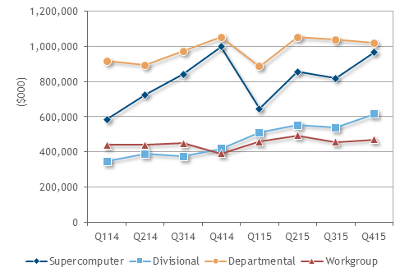
HPC Server Revenues by Segment Quarter Q114-Q415
Departmental still largest sector—but maybe not for long
Supercomputer sector erratic as usual, but trending up
Divisional shows stable – and most positive - growth
Workgroup sector flattening out?
Source: IDC, 2016

Slide 7
Demand-Side (Buyer) Trends
2015 was strong – 11% growth in revenues!
  IDC estimates that 2016 revenue should only grow by about 3–5%, but growth is expected to return to historical averages of about 6–8% in 2017 out to 2020
New Petaflops – and Exaflops - System Announcements from China, EU, India, Japan, US, and others generating buzz
  But will that generate new sales, especially in the commercial sector ?
Big data combined with HPC is rapidly creating new solutions within the HPC space
  To better capture them, we created four new HPDA verticals:
  fraud and anomaly detection, marketing, business intelligence, other.
HPC-based cyber security is a new hot topic

Slide 8
Supply-Side (Vendor) Trends
HPC vendors will be looking hard at myriad options to differentiate their systems
  Processor options include Intel’s next-generation Xeon and KNL processors, ARM, OpenPOWER, GPU-based processors such as Nvidia’s, etc.
  And that’s just the start: memory schemes, interconnect, storage and software stacks are all increasingly negotiable
Indeed, the looming contest between Intel’s OmniPath and Mellanox’s InfiniBand could create some interesting dynamics in the interconnect sector.
The profusion of open organizations - such as OpenHPC, OpenCL, Open ACC, OpenStack, OpenPOWER, and Open Compute - could redefine the balance of free and proprietary HPC hardware and software.
  Major vendors will need to decide which dance partners to choose, and how much time and money to devote to each.
The growing need for HPC/HPDA convergence will create opportunities and challenges for vendors looking to satisfy a customer base in transition.

Slide 9
Industry & Market Overview
Competitive Landscape
Buyer Perspective
Future View of the Market
Advice for the Technology Provider
Notes:
{NOTE: The original globe artwork is moved over slightly as the image went off the slide. The change did not impact the integrity or flow of the image. Image is GROUPED}

Slide 10
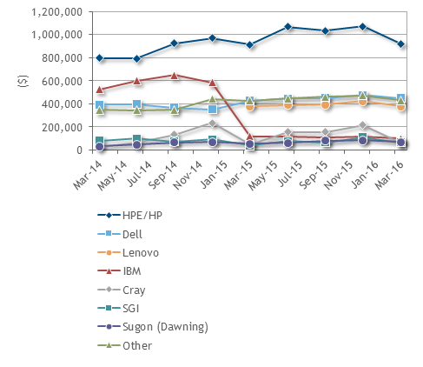
Major HPC Vendors Market Sales: Q1 2014-Q1 2016
HPE solidifies lead
The market post-IBM/Lenovo x86 server sale has settled out –battle for second place has become essentially a two-way tie, with Dell and Lenovo.
Cray is second largest supercomputer segment vendor behind HPE.
Dell is second in both departmental and workgroup segments.
Source: IDC, 2016

Slide 11
Changes in the Strategically Important Supercomputers Segment
What a Difference a Few Years Can Make
Source: IDC 2016

Slide 12
HPC Vendors Market Sales and Market Shares Q1 2016 (in $000s)
Source: IDC, 2016

Slide 13
Total 2015 HPC Ecosystem Spending Exceeded $23 Billion (1990: $2B)
About the Market Growth
HPDA Driving Market Growth ---especially in the storage sector
Impact of HPC in the Cloud Growing
The ‘Others’ Gain Share
Rapidly Growing Deep Leaning Sector Creates New Demand
‘Open’ May Change SW Game
Push to Exaflops May Generate Sector Buzz
Source: IDC 2016

Slide 14
Industry & Market Overview
Competitive Landscape
Buyer Perspective
Future View of the Market
Advice for the Technology Supplier
Notes:
{NOTE: The original globe artwork is moved over slightly as the image went off the slide. The change did not impact the integrity or flow of the image. Image is GROUPED}

Slide 15
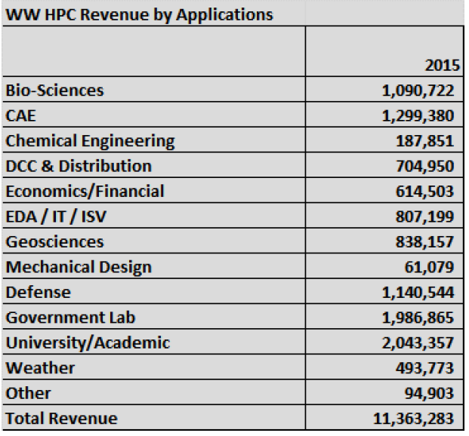
2015 HPC Market:
By Industry/Applications
University/academic is single largest HPC market segment (17.9%)
Government laboratories second (17.4%)
Biosciences currently at 9.5% but set to grow fast
Telecom/ISP/Data center—need to be considered?
IoT as well?
Source: IDC 2016

Slide 16
Growing Number of HPC Use Cases
Traditional HPC
Modeling & Simulation
HPDA
Today: Knowledge Discovery, BI/BA, Anomaly Detection, Marketing
HPC Anywhere
On-Premise
Cloud (Public, Private, Hybrid)
Private Hosted
More iterative methods (stochastic, parametric, ensemble)
More SMEs
Emerging: Precision Medicine, Cognitive, AI, IoT

Slide 17
Top Tech Trends to Watch
New Technologies
Processors: KL, GPUs, ARM, OpenPOWER, RISC-V
Interconnects: OmniPath, IB, 10 Ge
New Architectures
Heterogeneous: CP+ GPU + FPGA++ Others
Pre-Exascale and Exascale systems
New Software
Open Everything: OpenHPC, OpenCL, Open ACC, Open Stack, Open POWER, Open Computer
Dockers, Containers, Virtualization
Memory: NVRAM, 3D XPoint, HBM, HMC,, eRAM
Storage; Flash as the new Disk
Post CMOS Technologies
Deepening memory Hierarchy
Priority Shifts to the data center
HPDA Defined architectures
Managing the Deepening Memory Hierarchy
Managing Data movement at the data center level
Managing Heterogeneous architectures

Slide 18
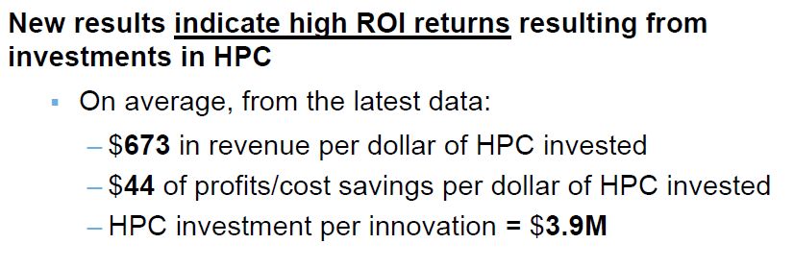
Demonstrated ROI Is Becoming Critical for Funding Supercomputers
The former Cold War arms race is now an economic race.
High-end supercomputers now cost $200-500 million
ROI can be a scientific advance or corporate profit, revenues, new jobs or retaining jobs
More large HPC centers have industry outreach programs
Source: IDC 2016

Slide 19
Industry & Market Overview
Competitive Landscape
Buyer Perspective
Future View of the Market
Advice for the Technology Supplier
Notes:
{NOTE: The original globe artwork is moved over slightly as the image went off the slide. The change did not impact the integrity or flow of the image. Image is GROUPED}

Slide 20
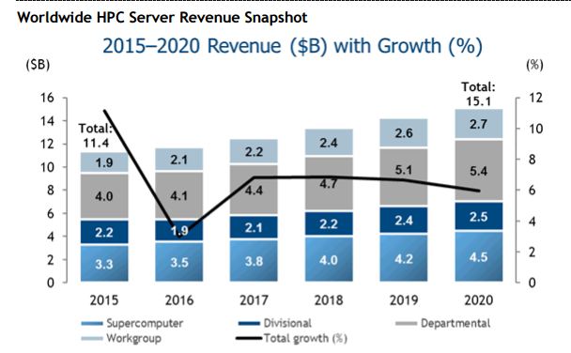
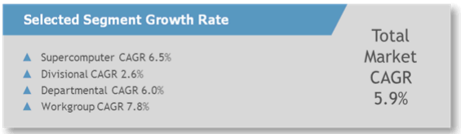
HPC Server Growth: 2015-2020
Issues to Consider:
Impact of HPC/Clouds?
ISVs in the new reality?
Data Centers as a growing driver of HPC design?
Entering an ‘Anti Commodization’ Era?
The Impact of Virtualization (bringing the cloud to HPCs)?
Power: More an Issue than FLOPS?

Slide 21
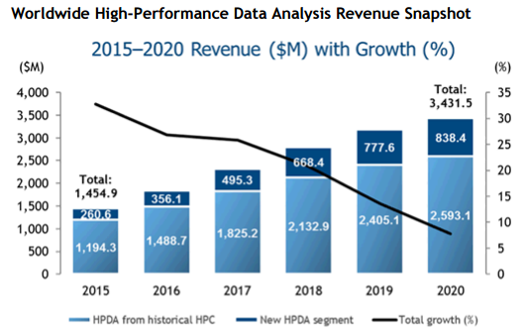
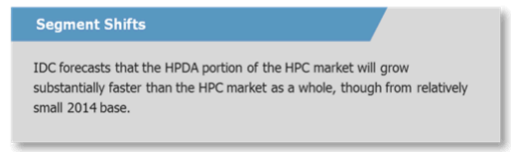
HPDA Revenue Growth: 2015-2020
Issue to Consider
New Use Cases every day?
Solutions in sight for Data Scientists shortage?
How Big will IoT Get?
Legal issue looming?
(Can big data stay big?)
New data sources on the rise including ‘dark’ data?
Privacy backlash?

Slide 22
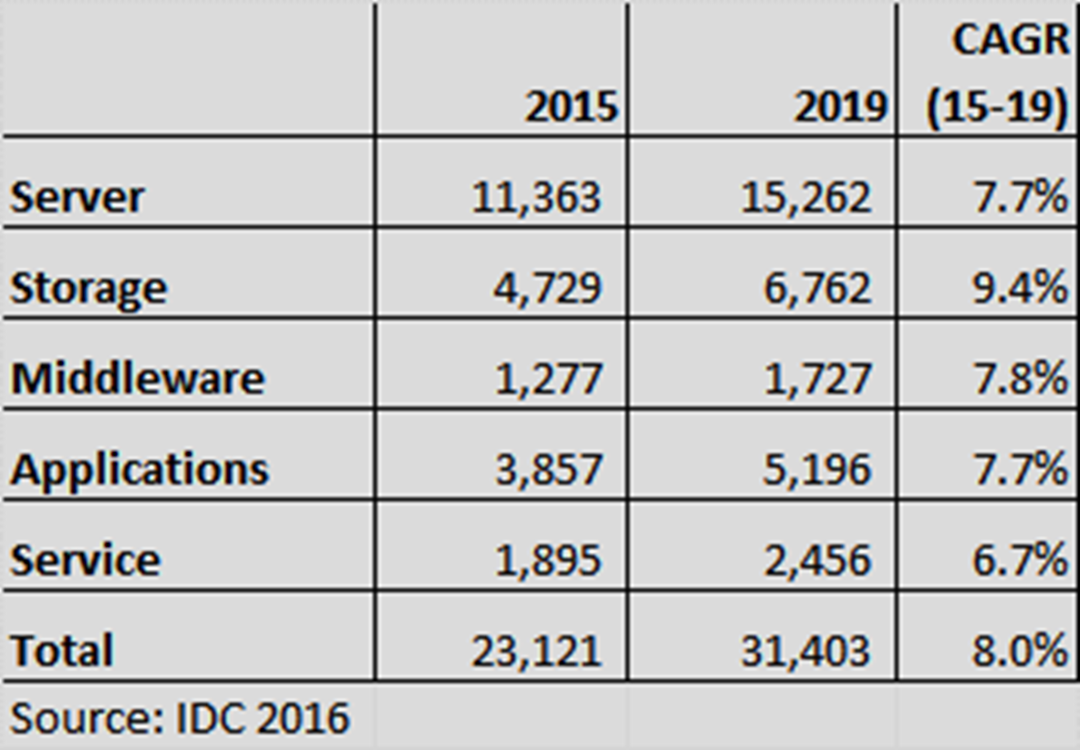
Good Prospects for the Overall HPC Ecosystem
Issues to Consider:
Impact of ‘Open’?
Exascale designs as game changers?
A New storage paradigm coming? (flash etc.)
Cloud providers shaking up the sector service/software sector?
Brexit Impact?

Slide 23
Industry & Market Overview
Competitive Landscape
Buying Criteria
Future View of the Market
Advice for the Technology Supplier
Notes:
{NOTE: The original globe artwork is moved over slightly as the image went off the slide. The change did not impact the integrity or flow of the image. Image is GROUPED}

Slide 24
Guidance for HPC Suppliers
Users will want the option of mixing HPC and HPDA applications seamlessly
And most will not have the in-house talent to understand, much less, supply the big data tools and techniques to make that happen.
Users will want the option of shifting workloads effortlessly across on-prem, hybrid, and cloud-based HPCs
Hardware and software to support that vision will be highly valued.
User will want the option of mixing of open and proprietary hardware and software
Support for open/standardized technology must be genuine and capable.
Demonstrated ROI not withstanding, every potential user will need to validate the economic value of a procurement.
It s no longer enough to stand above your HPC competitors, you must make your case against all other opportunities costs available to a potential HPC customer.

Slide 25
Guidance for the HPDA Suppliers
HPDA will drive some sales and help decide others.
Most HPDA work will be run on systems purchased not solely for this purpose, but there will procurements for HPC systems dedicated to high-performance analytics, especially in the life sciences and for fraud protection across massive databases
Most HPDA procurements will go to clusters — but not all.
Some will need enhanced interconnect and memory systems for example.
Not all HPDA problems involve analytics
Data-intensive M&S, and advanced visualization provides important analytical capabilities for many HPDA tasks.
There are opportunities to create tools for very large data sets
Vendors that create tools for use at this scale can use them as a lever to seize market leadership positions in HPDA.

Slide 26

Thank You
Any Questions?
Contact:
ejoseph@idc.com
sconway@idc.com
bsorensen@idc.com
kmonroe@icd.com

Slide 27
Related Research CY15-16
Document Title | Document Number | Publication Date
Worldwide High-Performance Data Analysis Forecast, 2016–2020 | IDC US41458316 | June 2016
Worldwide HPC Server Forecast, 2016–2020 | IDC US41318216 | June 2016
China's HPC Activities: Key Updates and Observations | IDC US41292316 | May 2016
The Changing Face of Memory Technologies: New Technologies Drive New Opportunities — And Create New Problems | IDC US41212215 | May 2016
Next Steps for the NSCI: Looking to Ensure a Long and Lively Life Span | IDC US40980816 | Jan 2016
IDC FutureScape: Worldwide High-Performance Data Analysis 2016 Predictions — Science and Industry Turn to HPC for Mission-Critical Big Data Challenges | IDC 259921 | November 2015

